Slide 1


AUG FIT
AUCSC 320
Software Engineering II
Oscar Jaimes, Nathan Pelletier, Barret Sardoff
Notes:
Do the Intro to the project on the title screen ------------------------------------------------------------------------------------------------------------------------------------------ -----------------------------------------------------------------------------------------------------------------------------------------------------------------------------------------------------

Slide 2
Overview
Client Q&A
Wireframes
Formal Requirements
High Level Design
User Interface Screens
Architecture
Coding Standard
Work Plan

Slide 3
Questions Presented To Client
Demographic
Additional Features
Fitness Centre Information
Machine Included
Other Exercises
Machine Ordering
Videos
Pictures
Muscle Groups
Menu Style
Colour Scheme

Slide 4
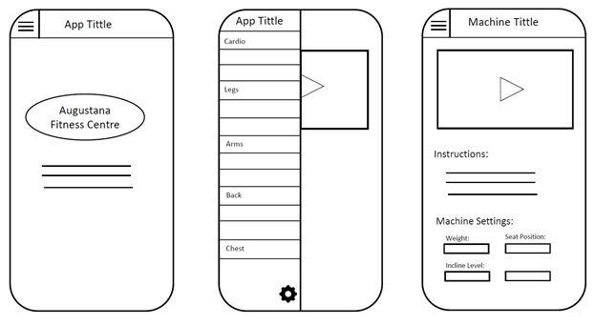
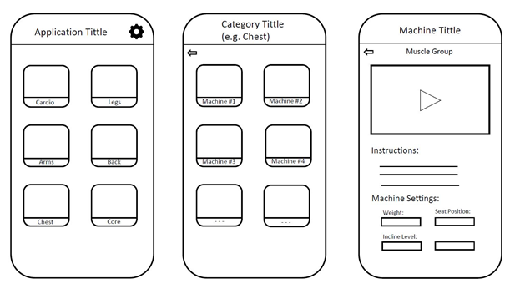
Wireframes Shown To the Client
Hamburger menu layout
Quick to access different categories
Visually appealing
Consistent
Basic symmetrical layout
Easy to follow, intuitive
Visually appealing and aesthetic
Consistent layout throughout

Slide 5
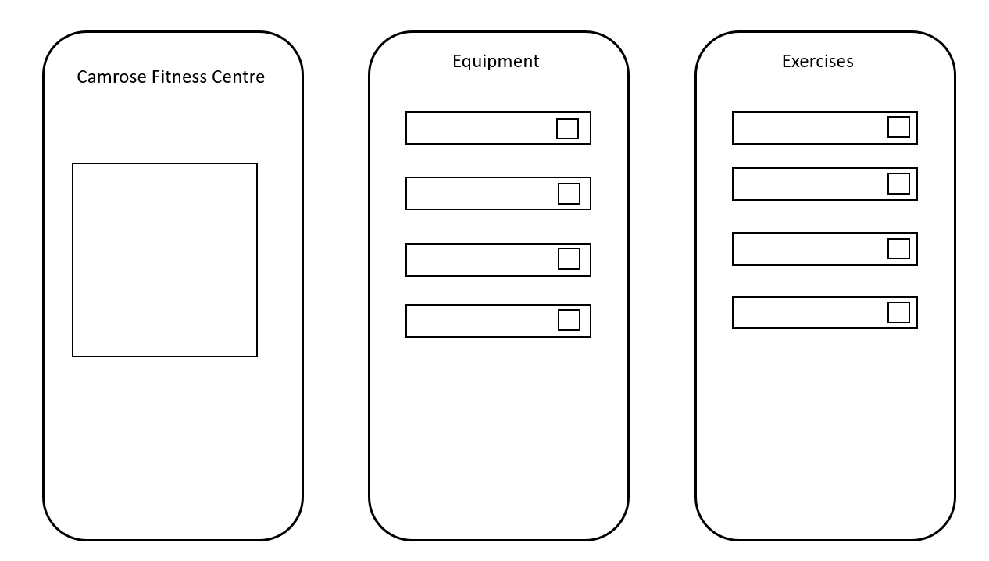
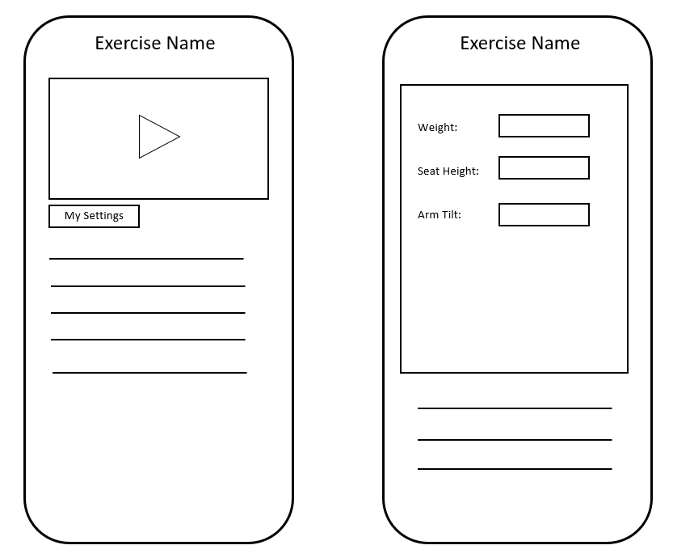
Wireframes Shown To Client
Loading screen eases people into the app
Easy to navigate menus that are consistent with one another
Compact page for each machine with a pop-up for machine options that leaves the page uncluttered
Easy to read and understand machine settings pop-up reduces short term memory load

Slide 6
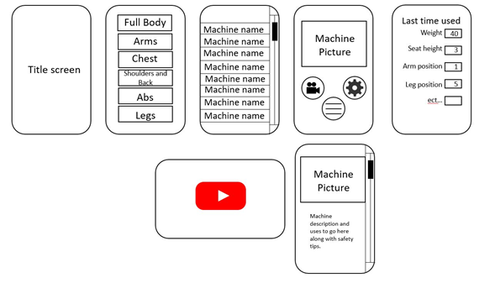
Wireframes Shown To Client
Title screen eases user into app
Large buttons with pictures easy to navigate
Seperate video, info and options screens

Slide 7
Formal Requirements
Must
Paramount Equipment
Videos
Options Menus
About Page
Pictures
Research
Instructions
Should
Google Maps
Video Permissions
Could
Create Videos
Recommendations
Progressive Graph
Won’t
Develop for Apple
Facility Map

Slide 8
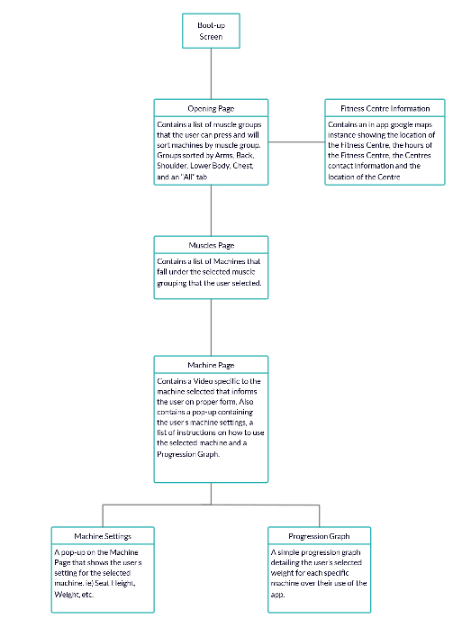
High Level Design
Boot-up Screen
Opening Page
Fitness Center Information
Contains a list of muscle groups that the user can press and will sort machines by muscle group. Groups sorted by Arms, Back, Shoulder, Lower Body, Chest and an “All” tab
Contains an in app google maps instance showing the location of the Fitness Center, the hours of the Fitness Center, the Centers contact information and the location of the Center
Muscles Page
Contains a list of Machines that fall under the selected muscle grouping that the user selected.

Slide 9
Machine Page
Contains a Video specific to the machine selected that informs the user on proper form. Also contains a pop-up containing the user’s machine settings, a list of instructions on how to use the selected machine and a Progression Graph.
Machine Settings
Progression Graph
A pop-up on the Machine Page that shows the user’s settings for the selected machine. ie) Seat height, Weight, ect...
A simple progression graph detailing the user’s selected weight for each specific machine over their use of the app.

Slide 10
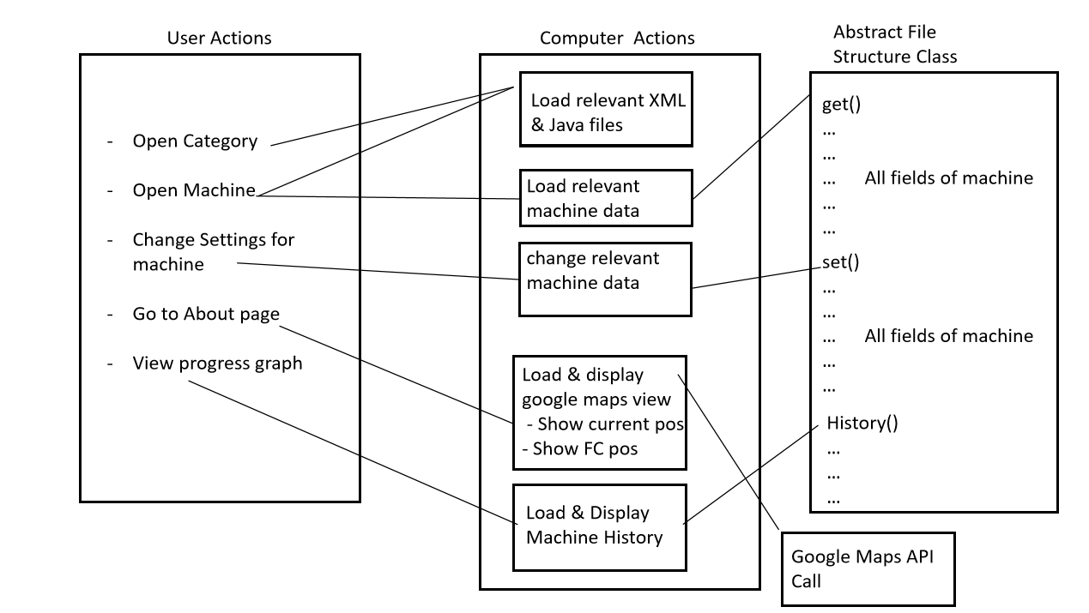
Basic Architecture

Slide 11

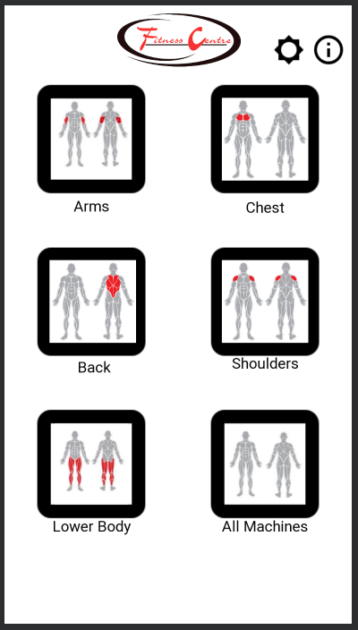
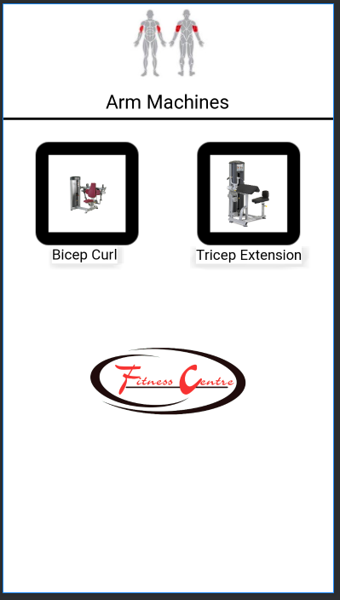
User Interface Screens

Slide 12
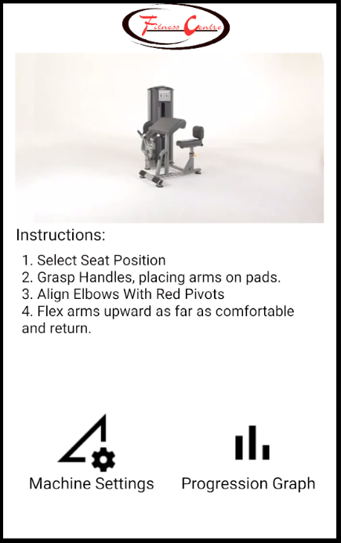
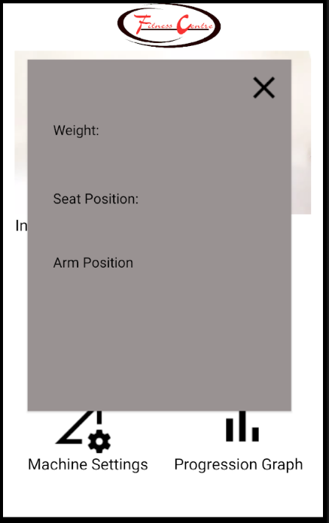
User Interface Screens

Slide 13

Notable Features
Progression Graph:
time vs machine weight graph
Google Maps View of Fitness Centre:
A small google maps view in the about page
Displays current position of user
Displays location of Fitness Centre
Solution:
Use Google Maps API
Request permission from user to use location.
Machine Weight
Time
Possible Solution:
Make a list of all user inputed weights and get the date
Plot points with a GraphView

Slide 14


Coding Standard
Following Google Java style guide
Consistency between programmers
Reputable standard
Easy to follow
Easy to find

Slide 15
Work Plan
Videos
Pictures
Research Proper Form for Machines
User Settings
First time user setup
Progression Graphs

Slide 16
Questions?

